Slide 1

NextHikes IT SOLUTIONS
Exploratory Data Analysis for Real Estate Pricing: Unveiling the Dynamics of House Valuation in a Dynamic Market
RAHUL E.R.

Slide 2

01
02
Dataset Overview
Key Findings from Univariate Analysis
CONTENTS
CONTENTS
03
04
Multivariate Relationships Impacting House Prices
Final Business Solution

Slide 3

DATA OVERVIEW
The dataset contains detailed information on residential properties, including:
Property size and structure
Construction year and age
Quality and condition
Amenities (garage, pool, basement)
Sale year and sale price
The target variable for analysis is SalePrice.

Slide 4
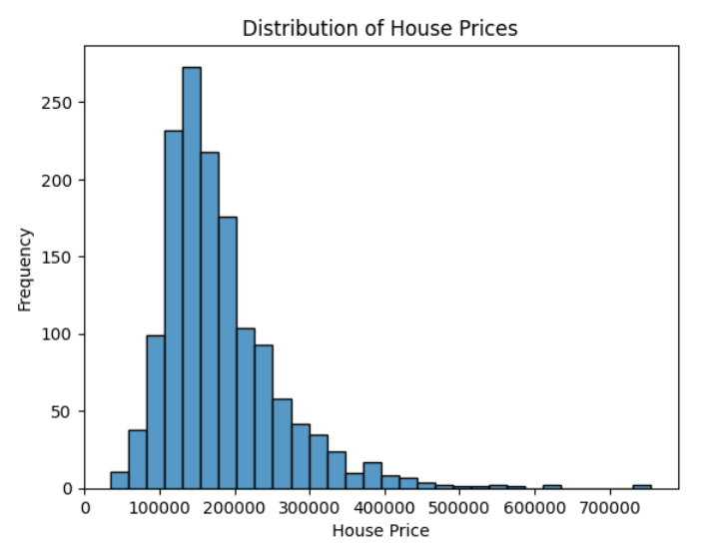
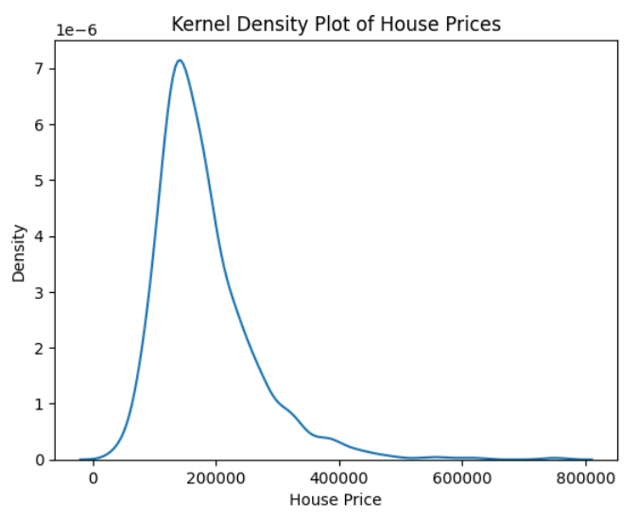
Key Findings from Univariate Analysis
House Price Distribution
House prices show a right-skewed distribution.
Majority of properties fall in the mid-price range, while a small number of premium properties form high-value outliers.
Interpretation
This indicates the presence of luxury properties that significantly raise the upper price range. Pricing strategies should therefore be segmented, rather than uniform.

Slide 5
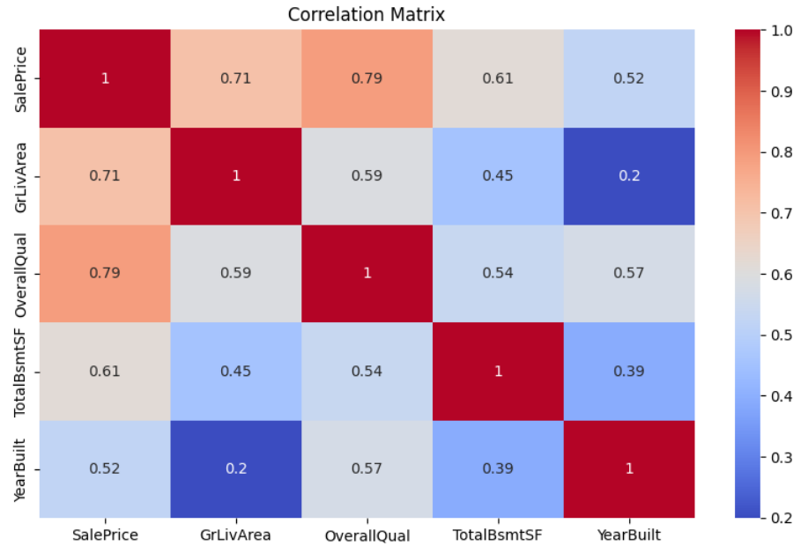
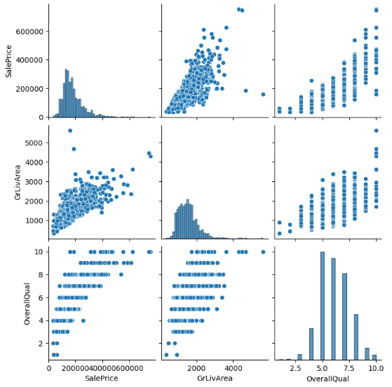
Key Findings from Multivariate Analysis
Multivariate analysis reveals strong positive correlations between house prices and features such as overall quality and living area. Scatterplot matrices help visualize dependencies and trends between multiple variables simultaneously.

Slide 6
Based on correlation analysis and scatterplots:
Feature | Impact on Price | Insight
OverallQual | Very High | Higher construction and material quality leads to premium pricing
GrLivArea | High | Larger living spaces significantly increase price
TotalBsmtSF | Moderate | Finished basements add value
YearBuilt | Moderate | Newer homes are priced higher
Key Insight
Quality and usable living area are more influential than just the number of rooms.

Slide 7

Feature Engineering and Size Impact

Slide 8
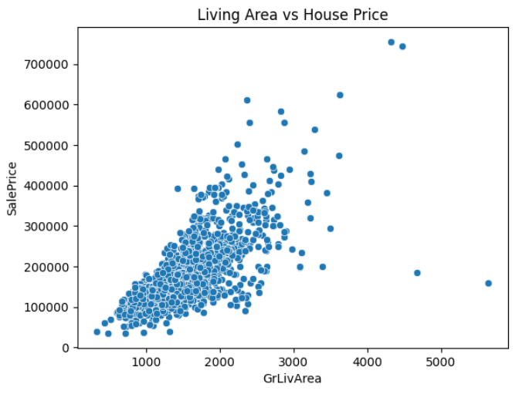
Living Area vs Sale Price
Strong linear relationship up to a threshold
Beyond a certain size, price increases show
diminishing returns

Slide 9
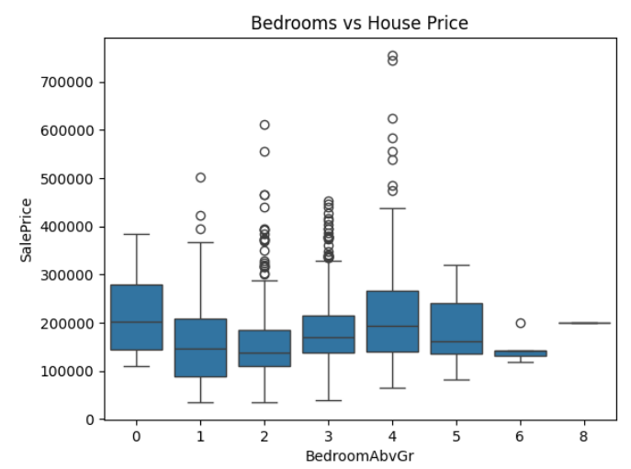
Bedrooms & Bathrooms
Houses with 3–4 bedrooms yield optimal pricing
More bedrooms without corresponding space does not increase value proportionally
Conclusion
Space quality matters more than space quantity.

Slide 10
Market Trends and Temporal Analysis

Slide 11
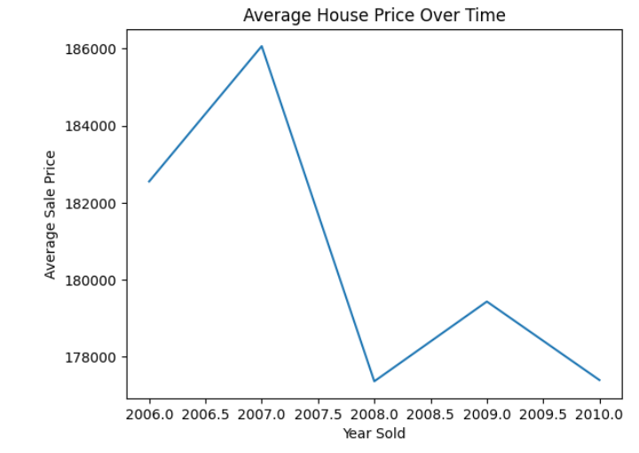
Historical Pricing Trends
Average house prices increased steadily over the years
Short-term fluctuations observed due to market conditions
Interpretation
Market conditions and economic cycles influence pricing, but structural property features remain the dominant drivers.

Slide 12
Amenities and Customer Preferences

Slide 13
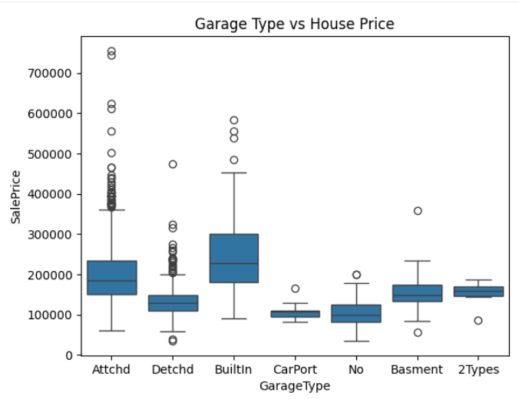
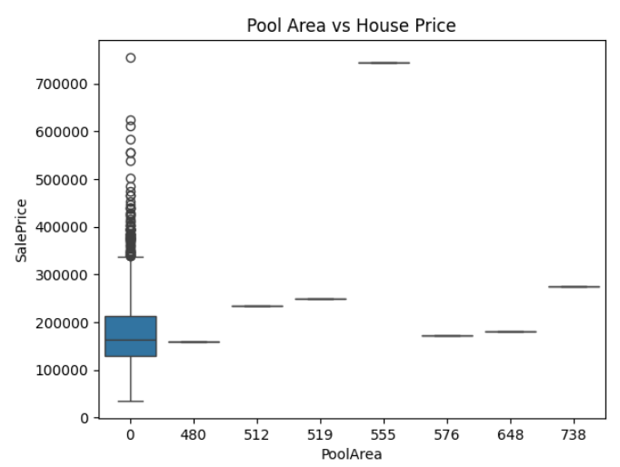
YOUR LOGO
Garage
Houses with attached or built-in garages command higher prices
No-garage houses sell at a discount
Pool
Pools increase value only in high-end segments
Minimal impact on mid-range properties
Amenities enhance value only when aligned with target buyer segments.

Slide 14
Strategic Pricing Recommendations

Slide 15
Separate pricing strategies for mid-range, premium, and luxury properties
Prioritize Overall Quality, Living Area, and Property Age over room count
Promote garages and premium finishes
Pools should be marketed selectively for luxury buyers
Use price per square foot as a competitive benchmark across neighborhoods

Slide 16
THANKS

